Slide 1
Team training call

Slide 2
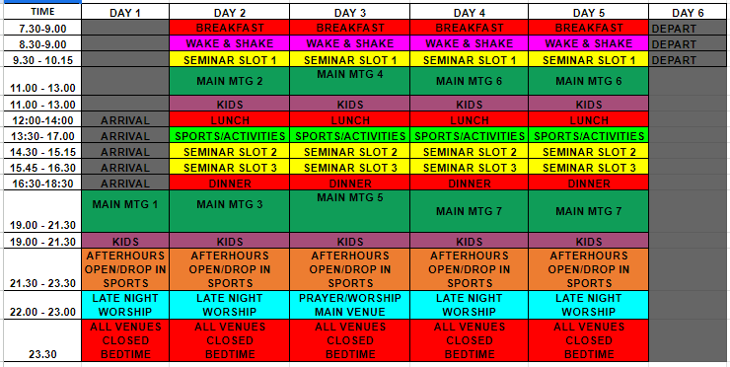

Slide 3
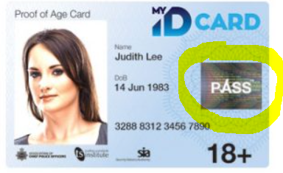
ARRIVAL FRIDAY July 28th
Team Leaders at midday and rest of team from 3pm
Drive on site to camping area (you will be directed) 10mph speed limit- please ensure you don’t park blocking any roads for emergency access – please bring your camping equipment
You will be checked in at the gate using your ticket QR code and then shown to your camping field (QR found on your ticket email)
Your vehicles will need to be parked across the road in the car park once you have finished with them for the week – unless blue badge (you will have 2 hours to remove them)
Please bring 1 form of photo ID either a driving license, passport or ID with the pass mark on it.

Slide 4
Arrival (2)
If you are bringing children or young people with you they will need to be with you at all times as this site will be “under construction” and we need to ensure the safety of everyone
Children will need to be signed in at the “kids 5-11” building between 3-4pm on Saturday afternoon – youth when their church group arrives. IF YOU HAVEN’T BOOK YOUR KIDS ON – WE ONLY HAVE SPACES LEFT FOR 5-11s
Any of group with serious medical requirements to go to introduce themselves to First Aid
Please check for train strikes and make alternative arrangements
DTI operates a zero tolerance approach to alcohol on site. We ask that no team members bring or consume alcohol on site at DTI.

Slide 5
Friday eve Team mtg
Dinner 6-7pm in the Team lounge (we will cater for children and youth)
Team mtg 7:30-9pm - please do your best to arrive in time for this mtg – important info at this mtg

Slide 6
DBS
Please can you make sure you have responded to all requests for your DBS information as we won’t be able to have you on team

Slide 7
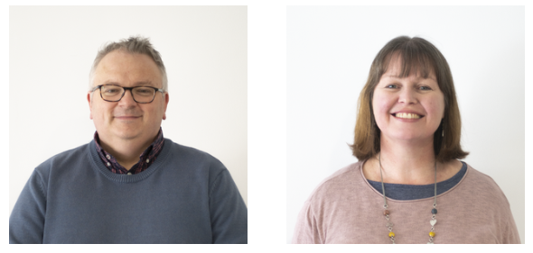
Team Pastors
Jo and Nigel Hemming – based in the Team Lounge

Slide 8
Team Leaders
Your team leaders are your first point of contact for any questions
They will confirm your rotas with you once on site
You will be invited to join a whatsapp group to be able to communicate with eachother all week
Will have a copy of policies that you may want to familiarise yourselves with
You will meet them very soon!

Slide 9
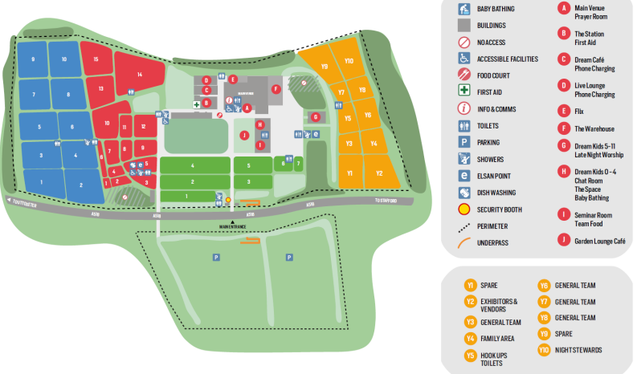
Camping
Team will be camping on the yellow field
If you are planning to camp with your church who are bringing youth – please get permission from them and complete any DBS checks they may ask you to do. You will need to wear a campsite pass lanyard to show you have permission - the youth leader will give this to you

Slide 10
We’ve gone cashless!
Everyone will receive a wristband with a unique tab on which will also contain their money wallet and their check in details
You can purchase vouchers ahead of time or bring cash/card to add to your wallet on site – very easy – will send out more info
This system will also significantly enhance our cash security and safeguarding on site with check in

Slide 11
Food
Food Vans:
There will be food vans on site which are selling a range of fast-food options
Tuck shops and cafes :
Closed during the main mtg
Team Lounge:
All meals served here; snacks and drinks available here as well as a place to rest your feet!
Breakfast 7:30-9am
Lunch 12:30-14:00
Dinner 16:30-18:30

Slide 12
Departure
We need to vacate the showground by midday on Thursday - we need your help to do this!
Please meet in the team lounge for breakfast time and we will distribute any final jobs to ensure we are off the site by midday

Slide 13
Safeguarding
Safeguarding lead (Penny Finn - based in the control room)
Safeguarding leads will be wearing BLUE dream team T shirts and can be contacted by ringing the DTI Control team - emergency number on your wrist band.
This year each person will have their own QR code on their wrist bands to identify Name, group leader, high alert needs, church
Every wristband will have the phone number for DTI control so assistance can be sought in an emergency.

Slide 14
Safeguarding
Every adult needs to wear a lanyard this year – please ensure you are always wearing yours even if off duty.
The cards on lanyard this year not only have your team name on it, they also show which teams have been trained to pray for young people and if they have access to the special zones (because they have had an enhanced DBS check) such as youth campsites, connect, prayer and chat areas (blue background)
Those that don’t will have the standard DTI red and you will need to pray with someone who has a blue lanyard if you find yourself praying for a young person
Inform the safeguarding team immediately if a youth discloses or you have a safeguarding concern.
We will email out a 10 min video re safeguarding at DTI – please watch

Slide 15
Pastoral Care
First port of call are CAMPSITE HOSTS 24 HOUR NIGHT STEWARDS AND FIRST AID
EQUIP TEAM
CHAT ROOM - for young people who want to talk something through CONNECT ROOM - this room is not advertised. Young people are directed to
Connect via Equip Team, Prayer team, Chat room, Link Team, and safeguarding team. Team of professionals for those young people who need it.
ADDITIONAL NEEDS TEAM - THE SPACE PRAYER ROOM TEAM – for young people who want to learn how to pray LINK TEAM – looking to connect with young people who are not in the main meetings or are looking lost on site
SIGN LANGUAGE – all main sessions will have British Sign Language and a hearing loop

Slide 16
Illness
We have an incredible 24 hours a day first aid team on site
Please do let your team leader know if you are poorly before you come to DTI or whilst at DTI
Please do not call an ambulance yourself - always call the emergency number on your wristband - 24 hours a day

Slide 17
Helpful things to know!
You can leave site if you are off duty – you will be checked and in and out – please always wear your wristband
Please always come back in time for your shift – Teamwork makes the Dream work!
If you are staying off site – please park your car in the main delegate car park everyday – unless blue badge
We have night stewards who will be awake all night – please do bear this in mind when you are waking up in the morning – ssshhhh
We ask that the campsite is quiet by midnight – there will be children sleeping in your field too
24/7 first aid
Any emergency please call the emergency number on your wristband
Extra showers – Bingley Hall (main venue) 7-8:30am

